Slide 1
Csc-201 Data Structures
Presented By:
Marina Gul

Slide 2
Course Objectives
Data Structures is one of the core courses in computer science degree program. It allows students to learn how data is structured inside computer memory and how to manipulate it through different algorithms.
During this course, students will learn different data structures including array, stack, linked list, graph, table etc. and they will also learn how to retrieve and store data in these data structures.

Slide 3

Why this course ?

Slide 4
Recommended Book
Data Structures and Algorithms in Java, Robert Lafore, 2nd edition
Data Structures and Algorithms in Java, Michael T. Goodrich, 6th edition

Slide 5
Grading Criteria
Mid Term (Theory+Lab) = 30% +15%
Final Exam (Theory+Lab) = 50% +25%
Assignments & Quizzes = 10%
CP & CB = 5%
Project = 15% Report (2%), Software (10%), Presentation (3%)

Slide 6
Overview of the course
Array/LinkedList/StackQueue
Algorithm Complexity
Recursion
Search/Sort Algorithms
Project Demos and Vivas
Graphs and Applications
Trees and Applications

Slide 7
Lecture 1-3
Data Structures
Presented By:
Marina Gul

Slide 8
IN THIS LECTURE
The programming process
Algorithm, Pseudo code and Flowchart
Data Structures
Overview of Data Structures
Abstract Data Type (ADT)
Arrays

Slide 9
The programming process
We do not start straight with coding
For a given problem, we first develop an algorithm that details the steps required to solve a given problem
A pseudo code is an informal high-level description of the operating principle of a computer program or algorithm
A flow chart is a pictorial representation of an algorithm or pseudo code
It uses symbols to detail the program elements

Slide 10
Algorithm
A list of well defined steps required to solve a given problem
It is very descriptive and is much like spoken language

Slide 11
Example
Algorithm: Finding the minimum of two given numbers
Let the first given number be x and the second be y
If x is less than y then x is the minimum number
If y is less than x then y is the minimum number

Slide 12
Pseudo code
An informal high-level description of the operating principle of a computer program or algorithm
Easier to understand and implement
Provides a language agnostic mechanism to detail algorithms

Slide 13
Example
The same problem can be given in pseudo code as follows
Pseudocode: Finding the minimum of two given numbers
Precondition:
x is the first number
y is the second number
Postcondition:
Returns the minimum of x and y
If x < y then
return x
Else
return y
End If

Slide 14
Flowchart
A pictorial representation of an algorithm or a pseudocode
Shows the flow of control pictorially so its easier to understand and implement

Slide 15
Example
Start
x=0
y=0
Input x
Input y
Yes
x<y
No
Output x
Output y
Stop
Flowchart: Finding the minimum of two given numbers

Slide 16
Data Structures
Data structures: Conceptual and concrete ways to organize data.
Required for efficient storage and efficient manipulation
Used in designing of efficient algorithms
Data structures are usually abstracted into ADTs or abstract data types.
We know what a data type does but how it does it is hidden.

Slide 17
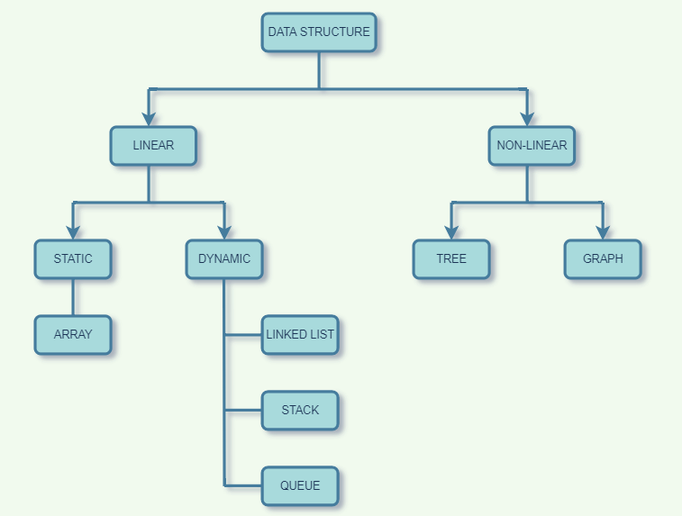
Overview of Data Structures
Notes:
Static data structure: It is a type of data structure where the size is allocated at the compile time. Therefore, the maximum size is fixed.
Dynamic data structure: It is a type of data structure where the size is allocated at the run time. Therefore, the maximum size is flexible.

Slide 18
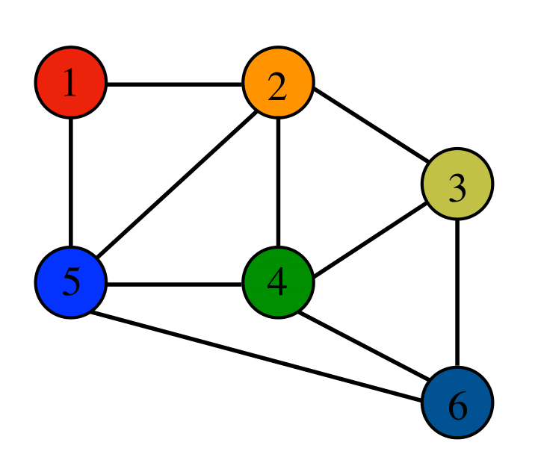
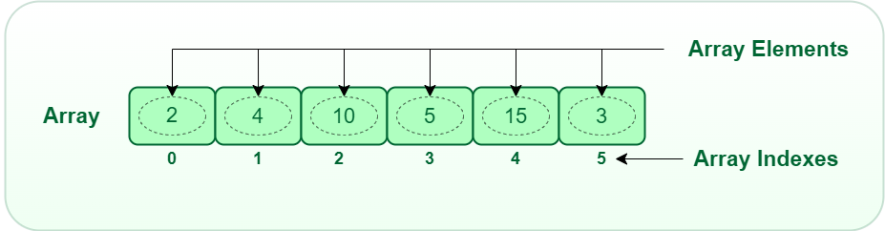
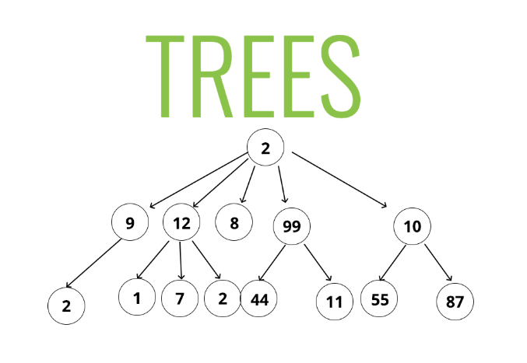
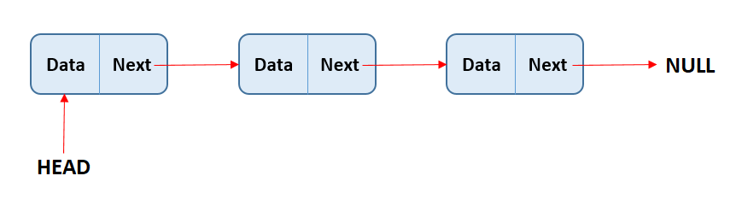

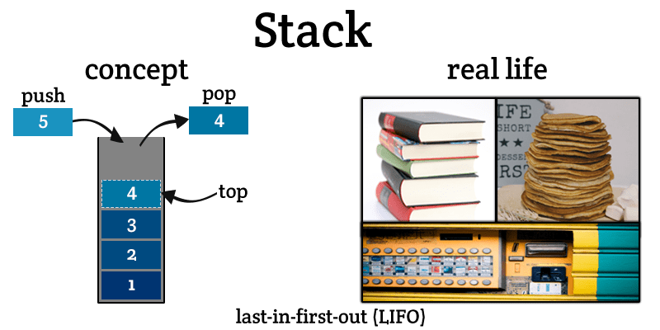
Graph
Linked Lists
Queue
first-in first-out (FIFO)

Slide 19
The Abstract Data Type (ADT)
Represented in a class
Contains both data and the methods that act on the data
Functions/Methods
Data/Fields/Attributes
Class
Objects

Slide 20
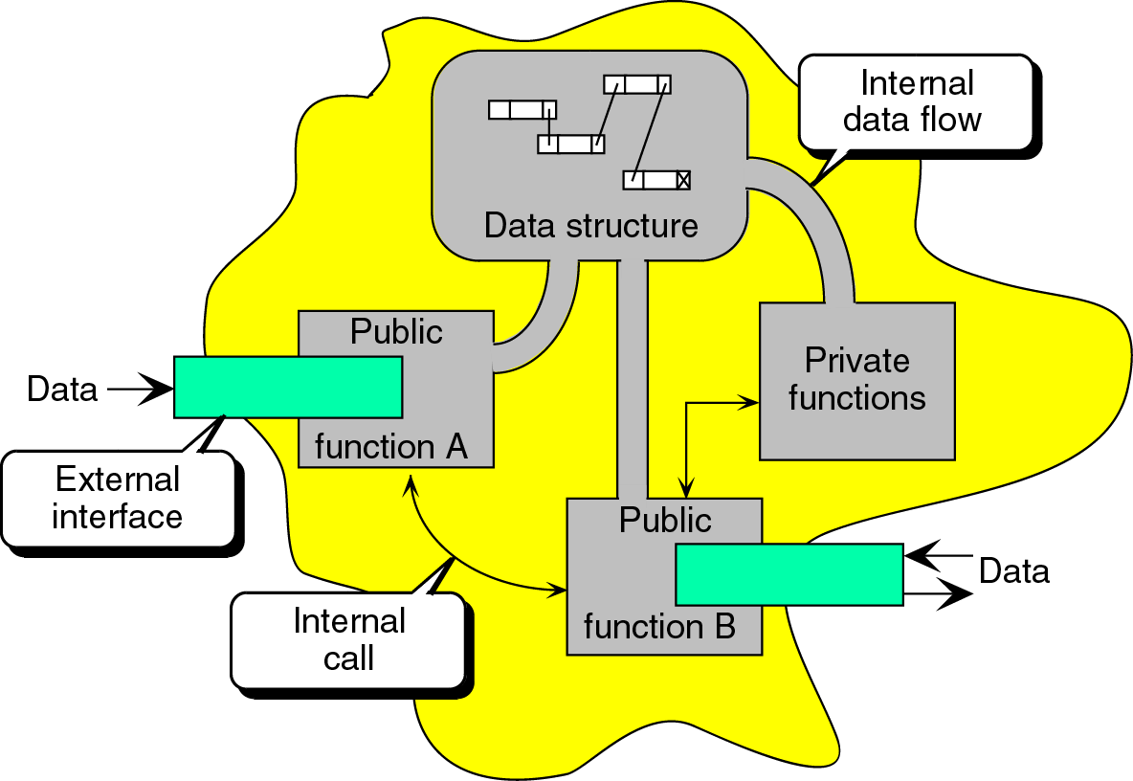
ADT Class Interface

Slide 21
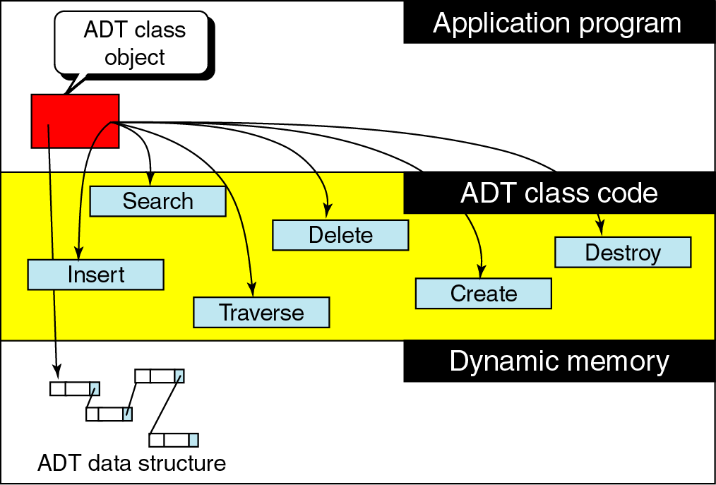
Data structure hidden in ADT definition

Slide 22
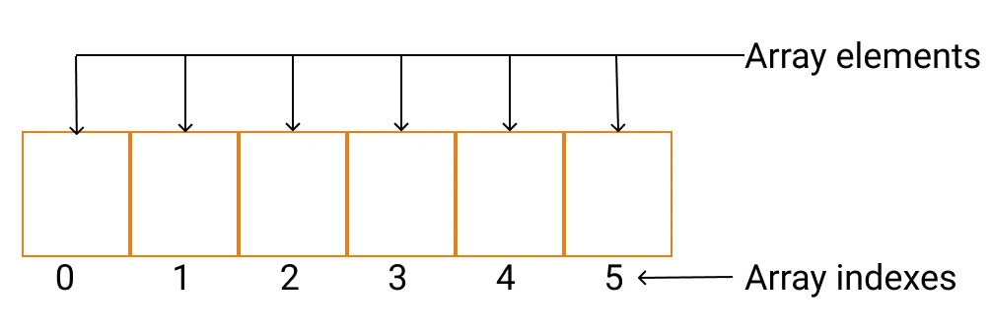
Linear Structures: Array
Contiguous area of memory consisting of equal-size elements indexed by contiguous integers.

Slide 23
What’s Special About Arrays?
Constant-time access (Read/Write)
array_addr + elem_size × (i-first_index)

Slide 24
Question
Given an array whose:
address is 1000,
element size is 8
first index is 0
What is the address of the element at index 6?
1040
1048
1005
1006
48
40

Slide 25
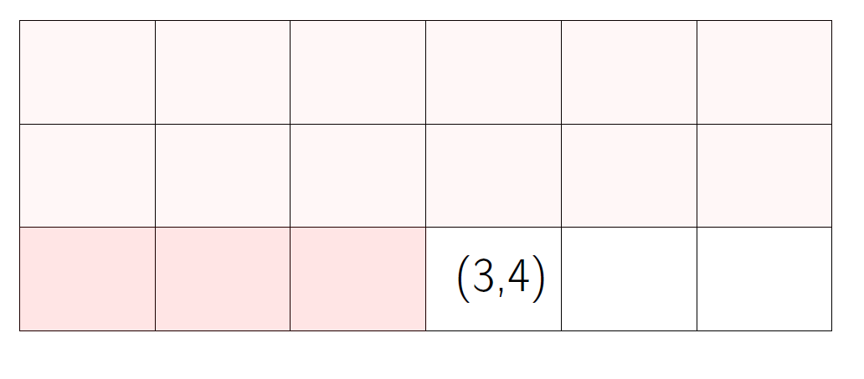
Multi-Dimensional Array
array_addr +
elem_size × ((3 − 1) × 6 + (4 − 1))
Notes:
2D arrays are also stored in a contiguous block of memory. This means that all elements are placed next to each other,
without any gaps.
For a 2D array, this can be done in two common ways: Following are general formula for array start with zero index
1. Row-major order (𝑖𝑛𝑑𝑒𝑥 = 𝑟𝑜𝑤𝑁𝑢𝑚 × 𝑛𝑢𝑚𝑂𝑓𝐶𝑜𝑙𝑢𝑚𝑛𝑠 + 𝑐𝑜𝑙𝑢𝑚𝑛𝑁𝑜 × 𝑠𝑖𝑧𝑒)
2. Column-major order (𝑖𝑛𝑑𝑒𝑥 = 𝑐𝑜𝑙𝑢𝑚𝑛𝑁𝑢𝑚 × 𝑛𝑢𝑚𝑂𝑓𝑅𝑜𝑤𝑠 + 𝑟𝑜𝑤𝑁𝑢𝑚 × 𝑠𝑖𝑧𝑒)

Slide 26
Times for Common Operations
 | Add | Remove
Beginning
End
Middle
5 | 8 | 3 | 12

Slide 27
Times for Common Operations
 | Add | Remove
Beginning
End | O(1)
Middle
5 | 8 | 3 | 12 | 4

Slide 28
Times for Common Operations
 | Add | Remove
Beginning |  | O(n)
End | O(1) | O(1)
Middle
 | 8 | 3 | 12

Slide 29
Times for Common Operations
 | Add | Remove
Beginning |  | O(n)
End | O(1) | O(1)
Middle
8 |  | 3 | 12

Slide 30
Times for Common Operations
 | Add | Remove
Beginning |  | O(n)
End | O(1) | O(1)
Middle
8 | 3 |  | 12

Slide 31
Times for Common Operations
 | Add | Remove
Beginning | O(n) | O(n)
End | O(1) | O(1)
Middle
8 | 3 | 12

Slide 32
Times for Common Operations
 | Add | Remove
Beginning | O(n) | O(n)
End | O(1) | O(1)
Middle | O(n) | O(n)
8 | 3 | 12

Slide 33
Read
Chapter 2 of Robert Lafore (Arrays)
Home work (solve exercise of chapter 1)
Watch
Java Tutorial : https://youtu.be/UmnCZ7-9yDY

Slide 34
Recap of the Lecture
A data structure is the organization of data in a computer’s memory or in a disk file.
The correct choice of data structure allows major improvements in program efficiency.
Examples of data structures are arrays, stacks, and linked lists.
Array: contiguous area of memory consisting of equal-size elements indexed by contiguous integers.
Constant-time access to any element.
Constant time to add/remove at the end.
Linear time to add/remove at an arbitrary location.

